Slide 1
PREDICTION THE SEVERITY OF AN ACCIDENT
(CASE STUDY)
Konda Lavanya

Slide 2
Introduction
Every year the lives of approximately 1.35 million people are cut short as a result of a road traffic crash. Between 20 and 50 million more people suffer non-fatal injuries, with many incurring a disability as a result of their injury.
Road traffic injuries cause considerable economic losses to individuals, their families, and to nations as a whole.
It would be great if real-time conditions can be provided to estimate the trip safeness.
In this way, it can be decided beforehand if the driver will take the risk, based on reliable information.

Slide 3
Business Understanding
Predicting crash injury severity is a crucial constituent of reducing the consequences of traffic crashes.
We can use the Machine learning models to Predict the severity of the Accidents based on the factors like the type of Road travelling,Location,number of Vehicles,Number of People on Road,weather any many more. These models Helps Road Users, Insurance Companies,Health Care providers,Government etc.
This help user to have a better understanding of Road Conditions, their impacts, helps to take initiatives to reduce the Accidents and to build New Infrastructure.

Slide 4
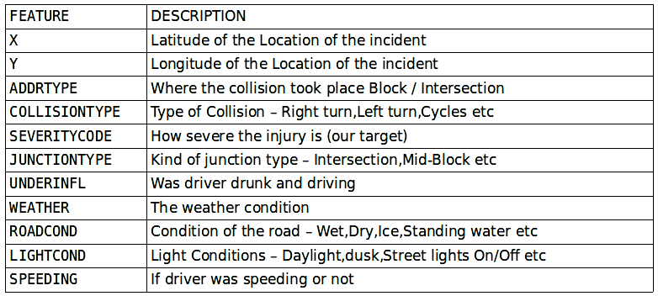
Data Understanding

Slide 5
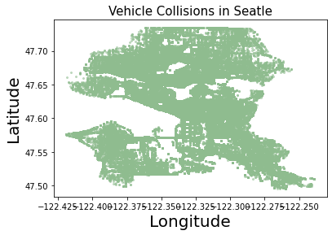
Lets us plot and try to understand the Vehicle Collisions in Seattle city.
The plot indicates that the accidents are taking places All over Seattle

Slide 6
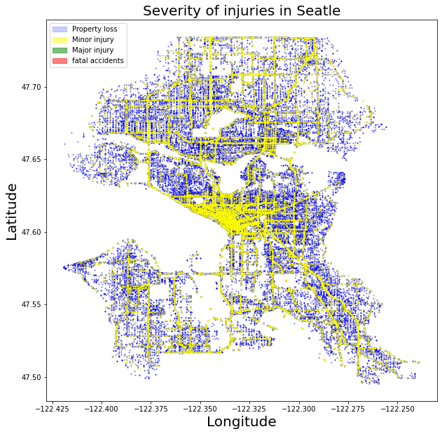
Severity of the collisions on a Scatter plot

Slide 7
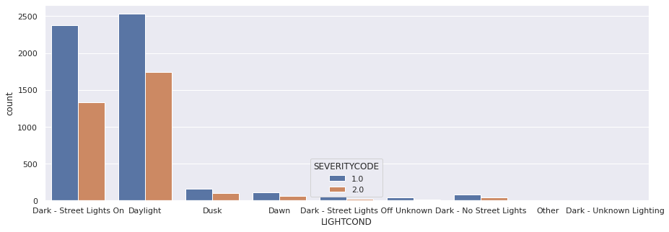
Data Exploration
Light condition vs SEVERITYCODE.

Slide 8
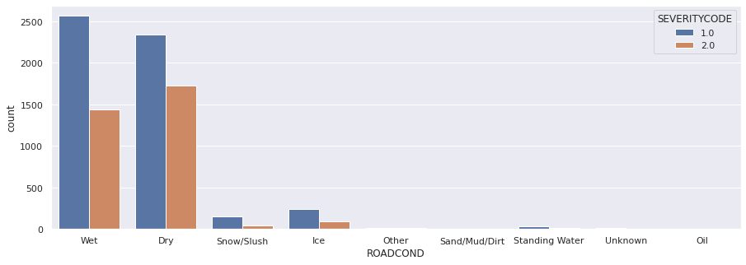
Road condition vs SEVERITYCODE.

Slide 9
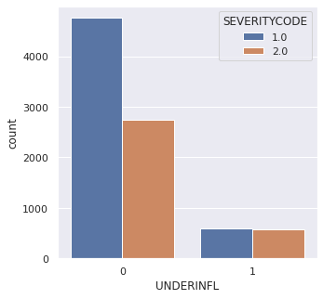
UNDERINFL vs SEVERITYCODE.

Slide 10
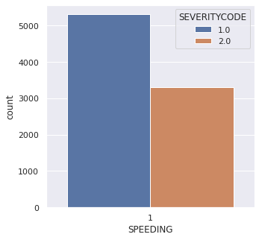
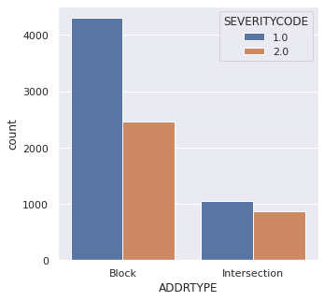
SPEEDING vs SEVERITYCODE ADDRTYPE vs SEVERITYCODE

Slide 11
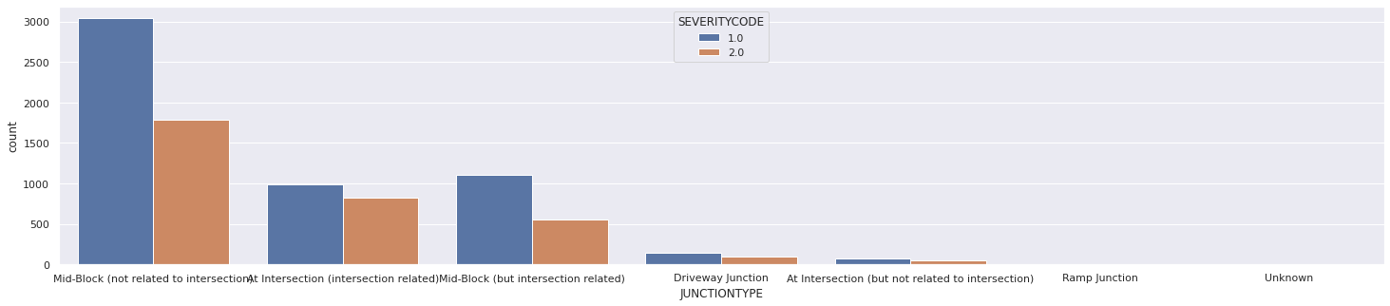
JUNCTIONTYPE vs SEVERITYCODE.

Slide 12
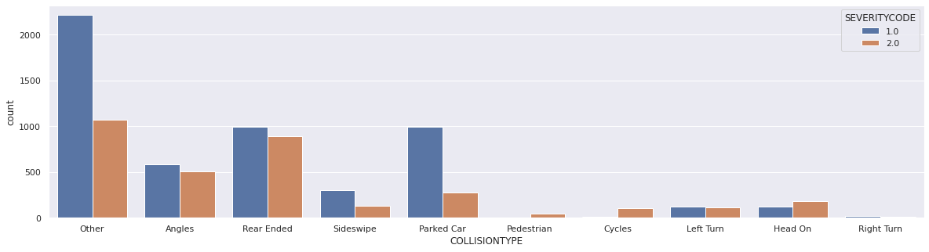
COLLISIONTYPE vs SEVERITYCODE.

Slide 13
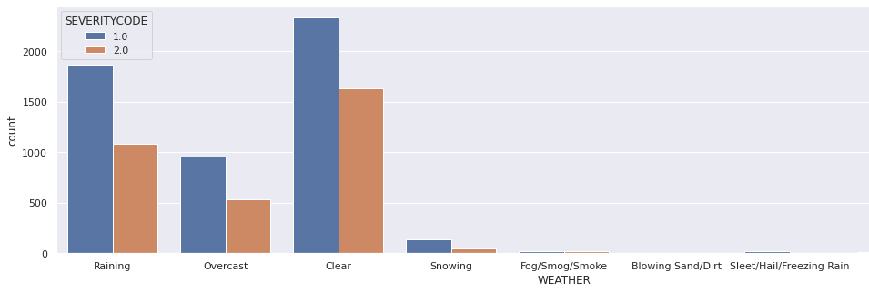
WEATHER vs SEVERITYCODE.

Slide 14
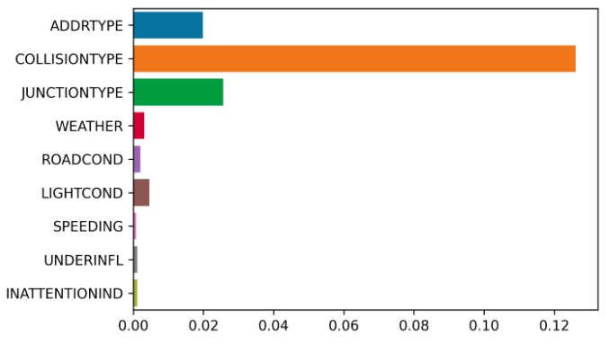
Feature Selection:
After Mutual Information Feature Selection from the Mutual Information Importance Values I choose to work with “ADDRTYPE","COLLISIONTYPE","JUNCTIONTYPE","UNDERINFL","WEATHER","ROADCOND","LIGHTCOND","SPEEDING","SEVERITYCODE"

Slide 15
Data Preparation:
Dropping all the rows with values Nan / Unknown
Changing the Values Y to 1 and N to 0
Since the property Loss and Minor injuries are common So let’s drop the rows with SEVERITYCODE - 0,2b,3.
As they are Categorical Values we need to insert dummy values, i.e perform One-hot Encoding
After checking the Number of rows with SEVERITYCODE 1,2. As we are required to make a balanced dataset we are dropping a few random rows with SEVERITYCODE 1

Slide 16
Modeling

Slide 17
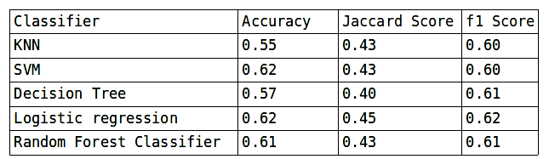
Results of 5 Classifiers used are:

Slide 18
Conclusions
Collisions which does not involve personal injuries are twice as frequent as the ones involving damaged people.
Accidents involving cycles or pedestrians are severe and involves injuries.
The riskier car collisions are the ones that hit the car from the rear end.
Intersection collisions are one of the most common types of crash
Left turns are also risky maneuvers which should also be avoided if the road users want to be safe.
Extremely dangerous weather and road conditions do not produce a quite significant accident rate, such as snow and ice. However ,caution have to be taken with rainy weather and wet roads, since after clear days and dry roads, these are the following conditions in order of importance.

Slide 19
Thank You!

